Slide 1

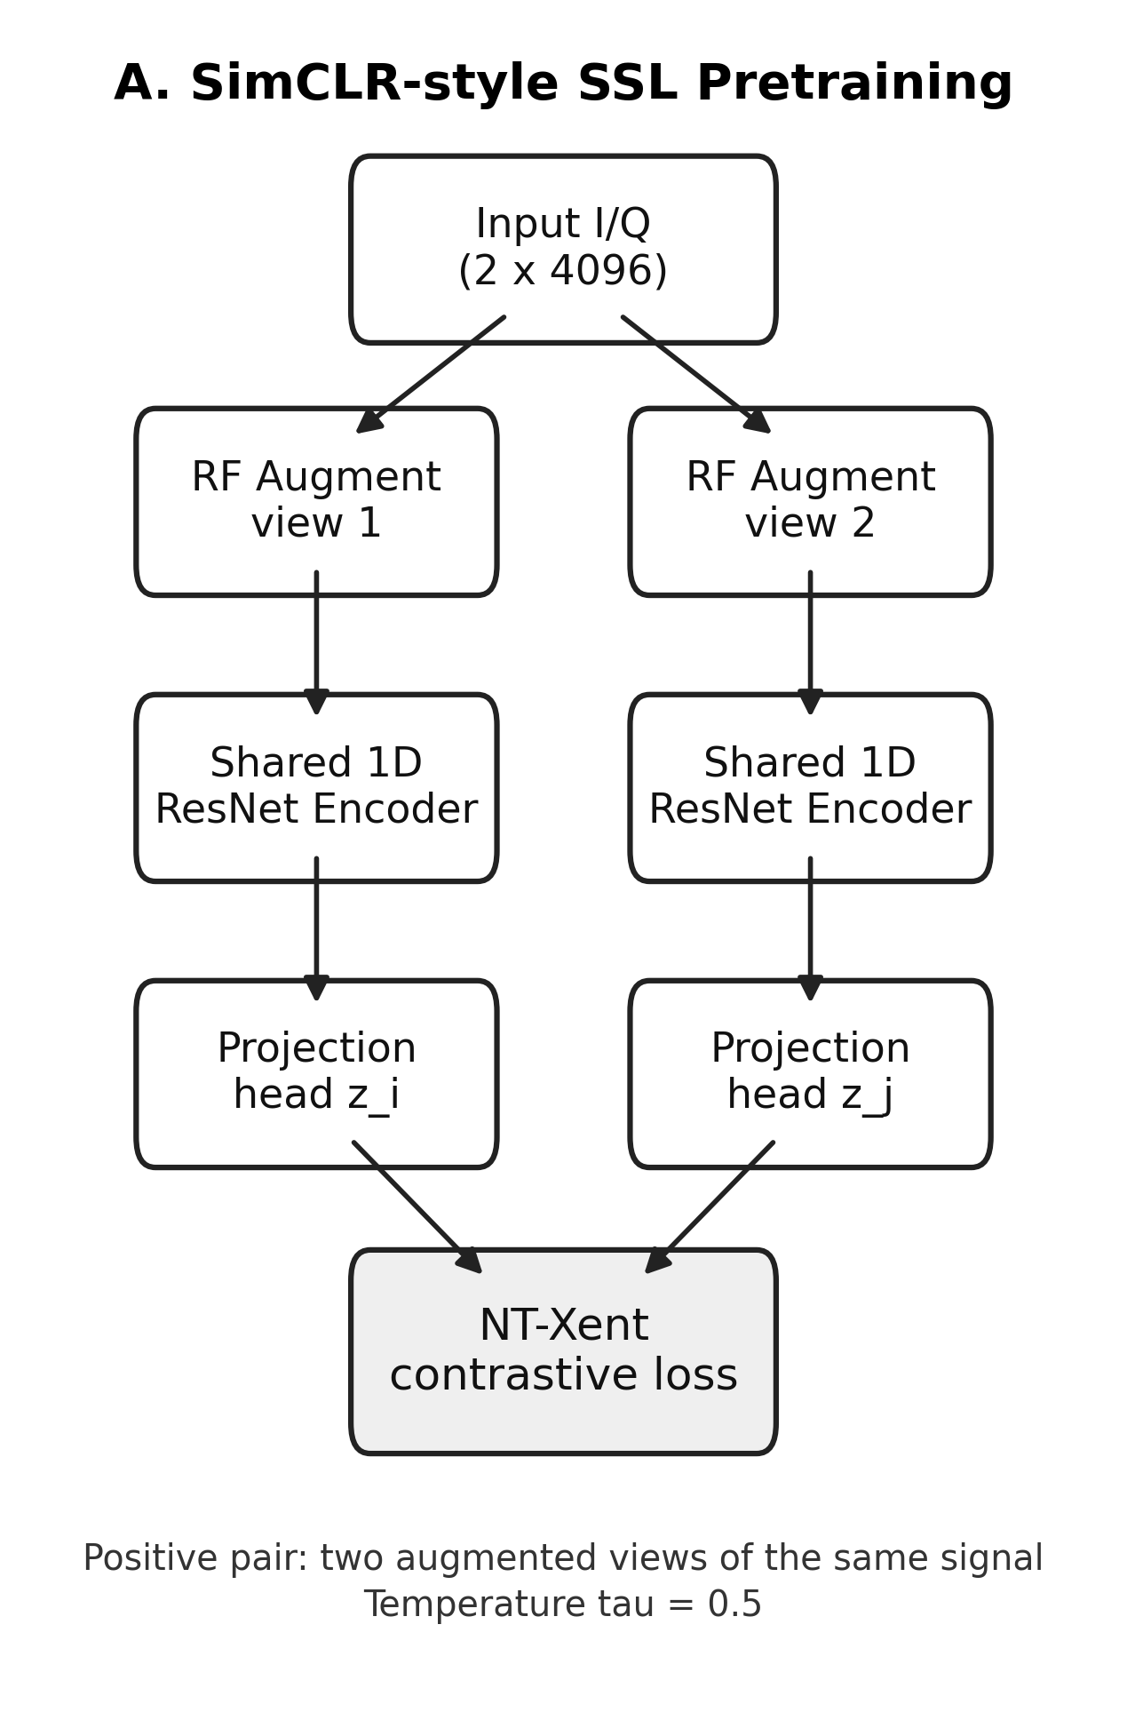
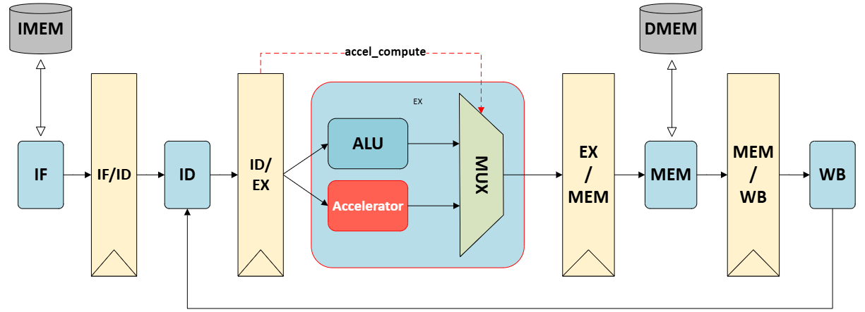
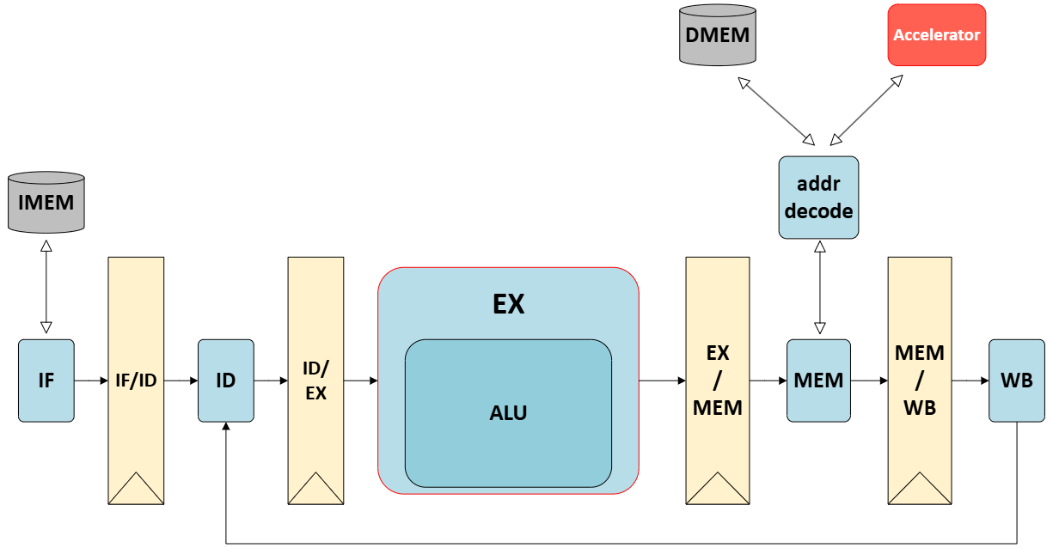
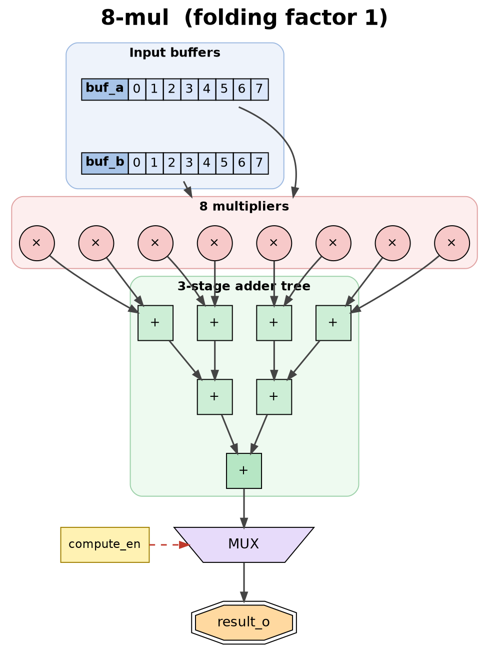
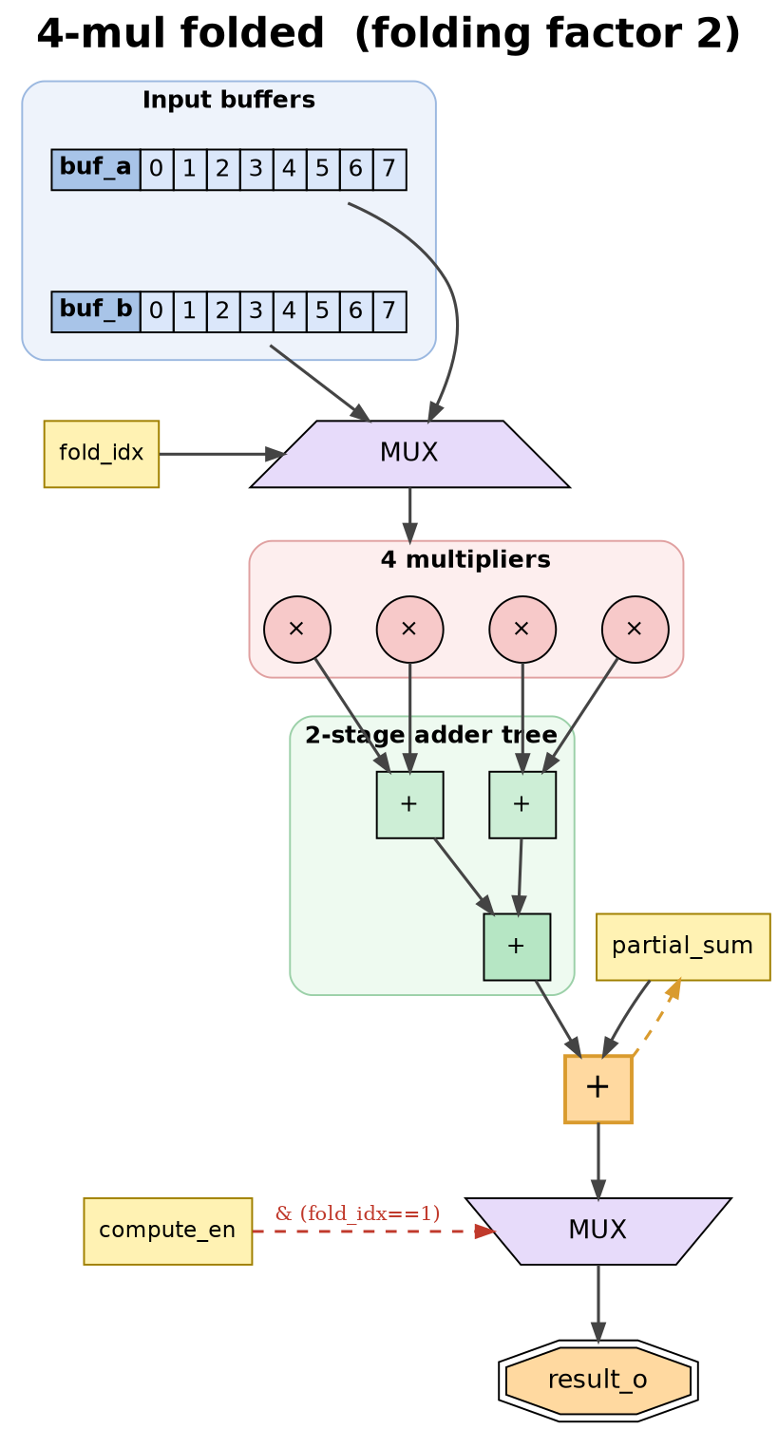
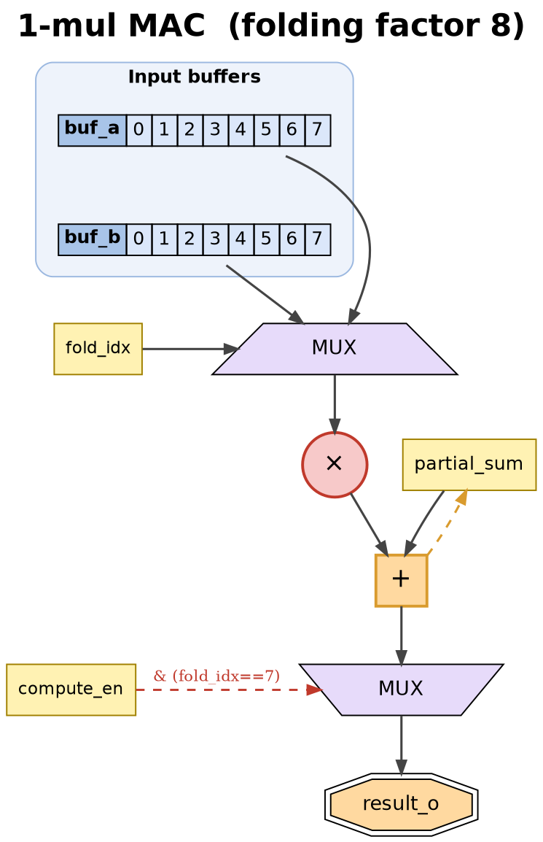
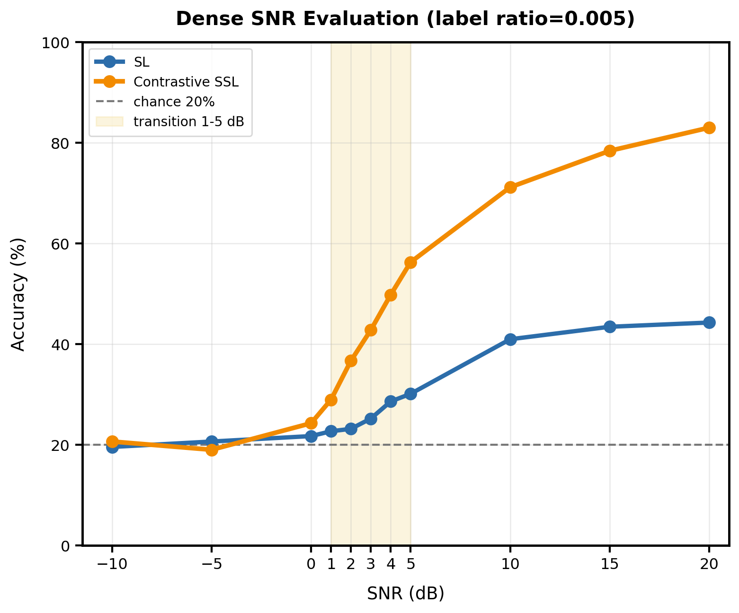
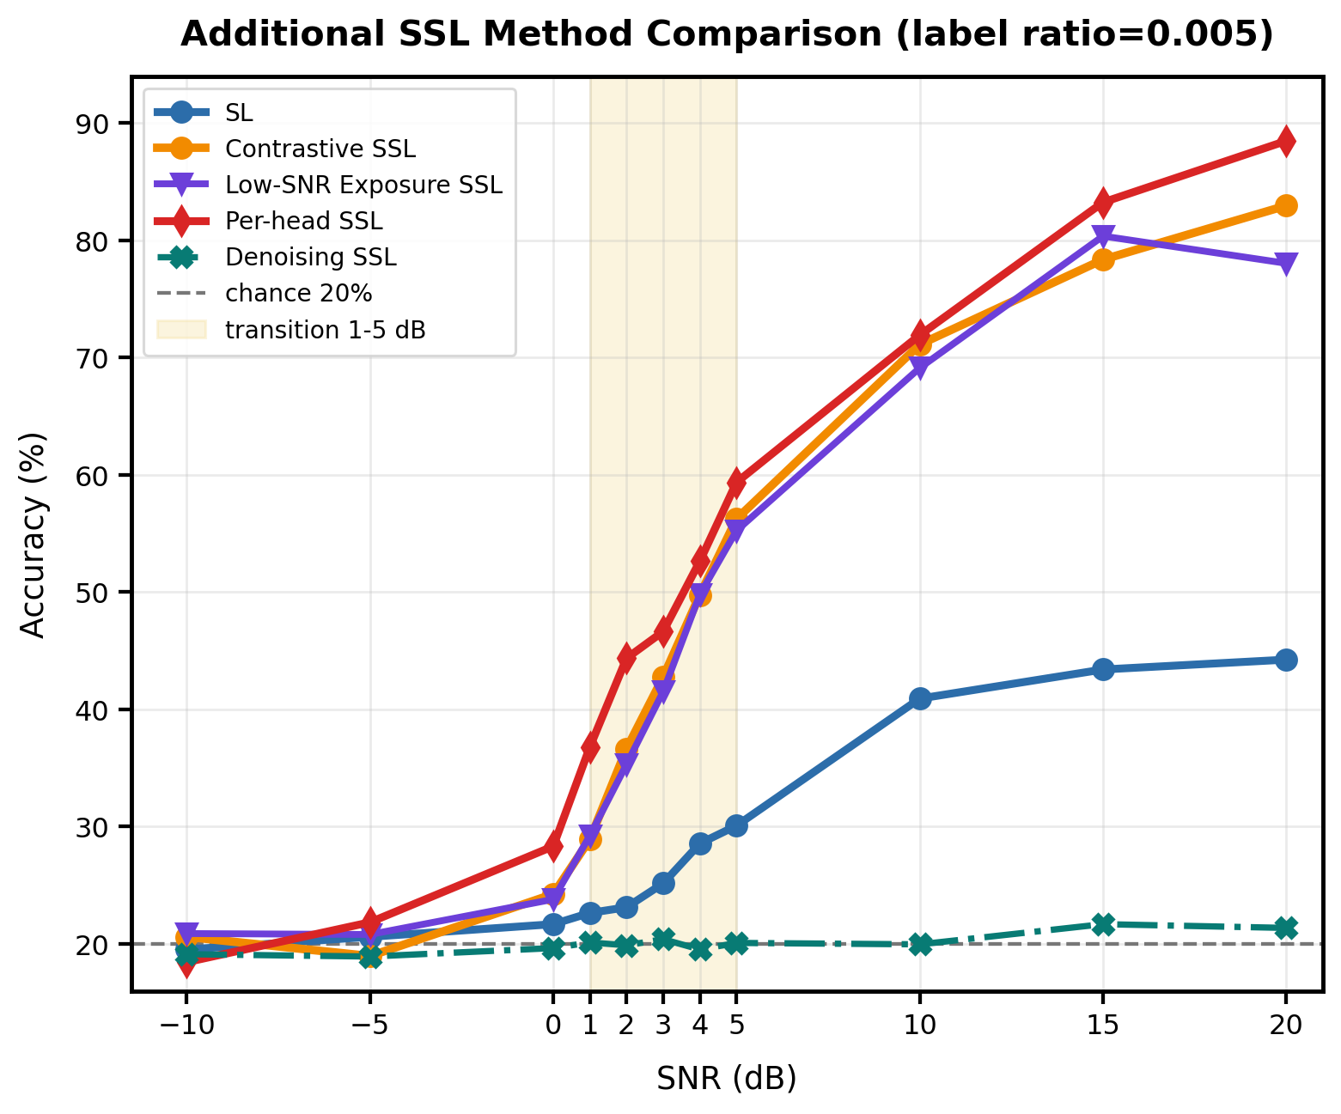
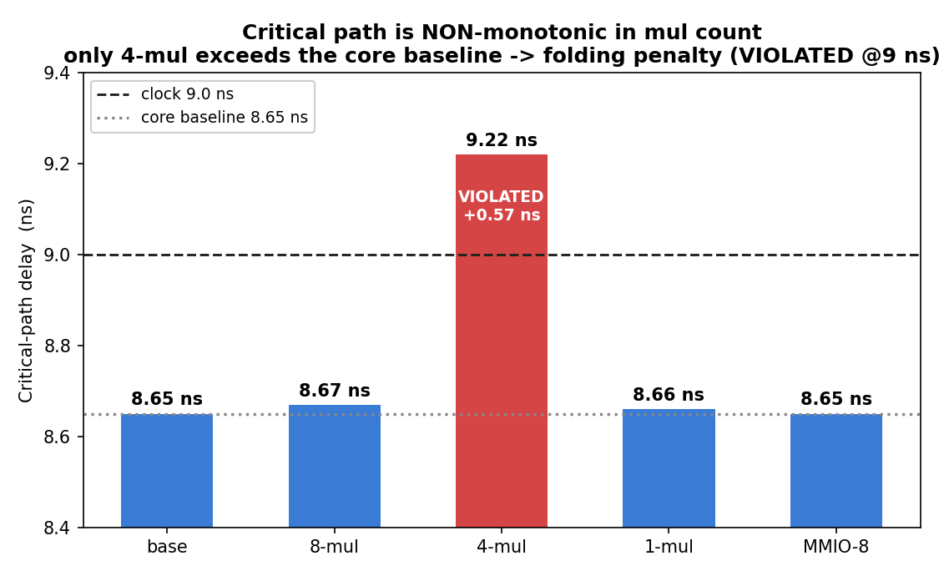
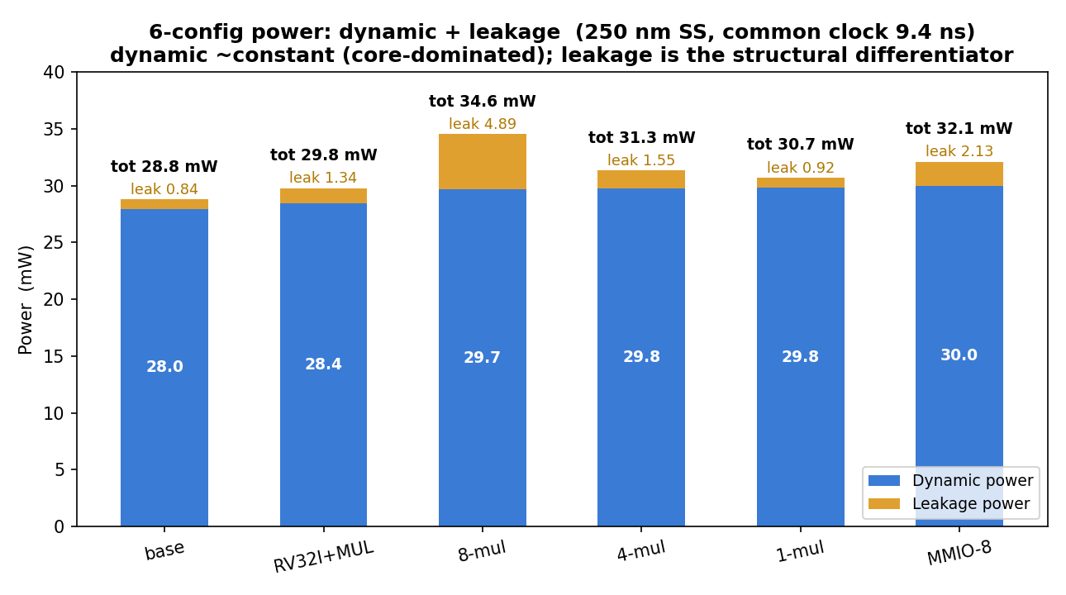
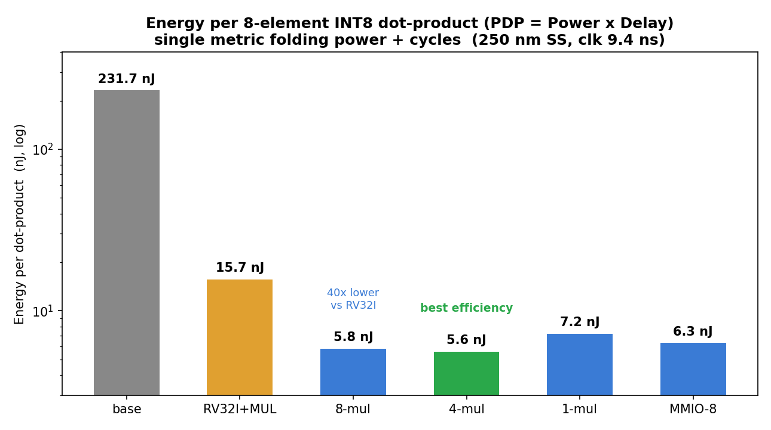
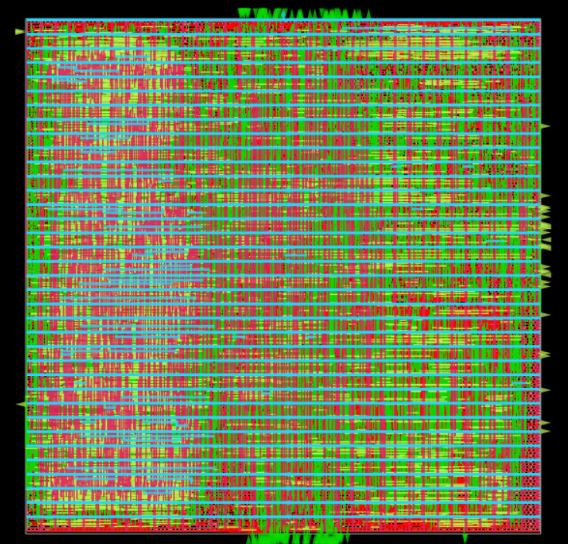
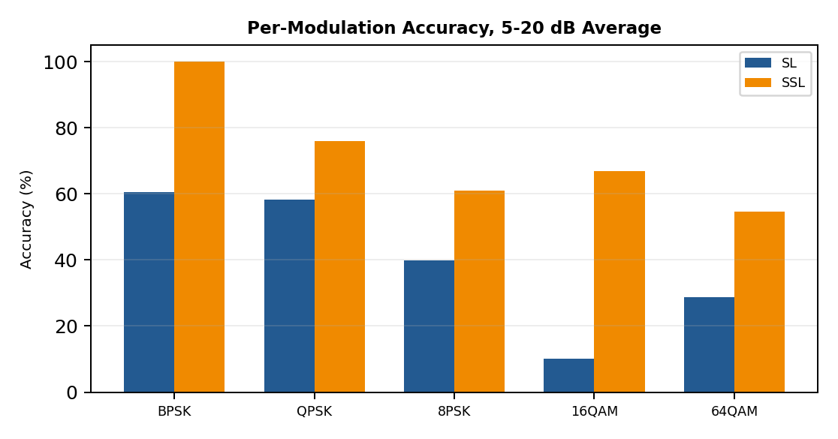


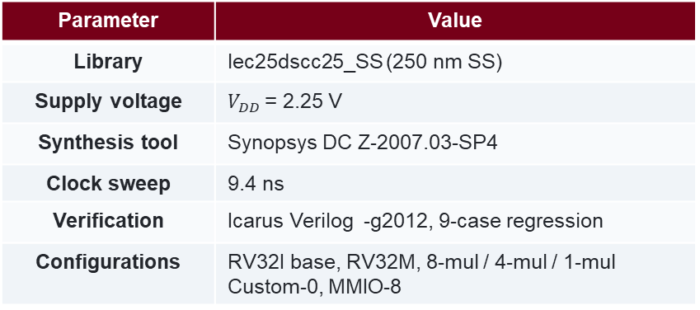
Design and ASIC PPA Analysis of an INT8 8-element Dot-Product Accelerator for a RISC-V Processor
Self-Supervised Modulation Classification under Varying SNR
Yoo, Seung Hyun | School of Biomedical Engineering, Korea University | asdfmid@korea.ac.kr
Advisor: Prof. Jonghan Kim
Woo, Jun Ha | School of Electrical Engineering, Korea University | jerry229@korea.ac.kr
Advisor: Prof. Jonghan Kim
1. Motivation / Setup
1. Motivation / Setup
Why a dot-product accelerator:
DNN inference is dominated by MAC operations.
Pure RV32I needs ~856 cycles per 8-element INT8 dot product;
RV32M still needs ~56.
Why 8-element INT8:
A 32-bit register packs 4× INT8 → two loads fill one 8-element vector.
8-wide stays within a single-cycle 3-stage adder tree at 250 nm.
Two integration styles:
Custom-0 ISA extension — 5 new instructions inside the EX stage.
MMIO attachment — standard lw/sw via address decoder,
accelerator outside the core.
Design axes:
Folding factor (8 / 4 / 1 multipliers) × attachment (Custom-0 / MMIO). → 6 configurations synthesized in one identical 250 nm flow.
Parameter | Value
Library | lec25dscc25_SS (250 nm SS)
Supply voltage | $V_{DD}$= 2.25 V
Synthesis tool | Synopsys DC Z-2007.03-SP4
Clock sweep | 9.4 ns
Verification | Icarus Verilog -g2012, 9-case regression
Configurations | RV32I base, RV32M, 8-mul / 4-mul / 1-mul Custom-0, MMIO-8
Current trend:
RF systems increasingly require automatic modulation recognition.
Machine learning-based classification research has become increasingly active.
Data issue:
Labeled I/Q datasets are costly to build,
while unlabeled RF signals are relatively easy to collect.
SSL idea:
Step1. pretrain an encoder using SimCLR-style
Step2. fine-tune encoder+classifier with few labels.
Research focus:
Identify which SNR regimes actually benefit from SSL under scarce labels.
Item | Setting
Task | 5-class I/Q modulation classification
Modulations | BPSK, QPSK, 8PSK, 16QAM, 64QAM
Input | 2 x 4096 I/Q samples
Label ratio | 0.25% 0.5%, 1%
Train SNR | 0, 5, 10, 15, 20 dB
Dense test SNR | -10, -5, 0-5, 10, 15, 20 dB
Models | SL, contrastive SSL, additional SSLs
Custom-0 (ISA extension)
MMIO attachment
2. Accelerator Datapaths
2. Low-label SL vs SSL Gain
SL -> SSL gain at label ratio 0.005
High
Region | SL | SSL | Gain
Severe | 20.06 | 19.78 | -0.28
Transition | 25.21 | 39.76 | +14.55
High | 42.85 | 77.48 | +34.63
Transition
Severe
Ratio | Transition | High
0.25% | +14.65 | +49.52
0.5% | +14.55 | +34.63
1% | +13.25 | +32.21
SSL shows limited benefit in the severe low-SNR region, where the received signal is too noisy for meaningful class separation. However,
clear gains appear in the transition and high-SNR regions, and these
gains remain consistent even when the label ratio is reduced from
1% to 0.25%. This indicates that SSL is most effective not simply
when labels are scarce, but when the signal still contains recoverable modulation patterns.
3. Added Methods and Per-head SSL Gain
3. PPA Comparison: 6 Configurations (Synopsys DC Z-2007.03-SP4 · lec25dscc25_SS (250 nm SS, 2.25 V) , 6 configs at common clock 9.4 ns)
High
Method | Role
SL | SL baseline
SSL | SSL baseline
Low-SNR Exposure SSL | Severe-SNR extra training
Denoising SSL | Loss reconstruction
Per-head SSL | SNR-aware multi-classifier
Transition
Region | SSL | Per-head | Gain
Severe | 19.78 | 20.14 | +0.36
Transition | 39.76 | 44.69 | +4.93
High | 77.48 | 81.21 | +3.73
Overall | 46.41 | 50.19 | +3.77
Folding Architecture is non-monotonic in critical path:
only mid-stage 4-mul exceeds the 8.65 ns core baseline by +0.57 ns. Full folding (1-mul) eliminates the adder tree and recovers timing.
Dynamic power is core-dominated (28 to 30 mW across all configs). Leakage is the structural differentiator — 8-mul shows 5× outlier due to 8 always-on multipliers + low-Vt cells.
Severe
PDP = energy per dot-product (Power × Delay).
• 4-mul: 5.6 nJ/op — best efficiency. Leakage −3× outweighs +1 cycle.
• 1-mul: 7.2 nJ/op — over-folded, +25 % vs 4-mul.
• Catch: 4-mul needs 9.4 ns clock (violates 9 ns).
→ Energy optimum costs timing margin.
Among the additional methods, Per-head SSL achieved the most consistent improvement in transition and high-SNR regions.
This suggests that SNR-specialized classification heads can better capture modulation characteristics that vary across noise conditions.
Despite these improvements, performance under severe low-SNR conditions remains close to random guessing, indicating that denoising alone is insufficient when signal structure is heavily distorted.
4. Per-Modulation Analysis
5. Takeaway
4. Physical Design, P&R (OpenROAD 130nm, sky130hd)
SSL is effective under scarce labels, but mainly in recoverable SNR regimes.
Per-head SSL adds the clearest improvement by specializing the classifier to SNR regimes.
Severe -10/-5 dB remains near chance, and noise exposure or denoising alone is not enough.
Stage | Tool/Step | Key result
1. Synthesis | Yosys + sky130hd liberty | 11,680 cells; 992+627 FFs
2. Floorplan | core area + utilization target | period_min 11.77 ns initially
3. Placement | global → detailed → resizer | period_min 8.79 ns post-place
4. CTS | Clock-tree synthesis (TritonCTS) | clock skew −0.13 ns
5. Routing | global + detailed (TritonRoute) | 0 DRC violations
6. Sign-off | final STA + IR-drop | slack +2.52 ns MET, fmax 112.5 MHz
Takeaway
- Folding is monotonic on area/leakage but non-monotonic on critical path
(mid-stage folding inserts MUX + accumulator in series, increasing serial depth)
- 4-mul achieves the lowest PDP (5.6 nJ/op) but requires a relaxed 9.4 ns clock
(energy optimum costs timing margin)
- MMIO is a viable ISA-free alternative at +3.6 % chip area and +3 cycles vs Custom-0.
Synthesis Results / using OpenROAD tools
SSL improves the accuracy of all modulation classes compared with SL, including relatively simple modulations such as BPSK. The gain becomes especially noticeable for higher-order modulations such as 16QAM and 64QAM, where class boundaries are more sensitive to noise and limited labels. Overall, the result suggests that SSL helps the encoder learn more robust and transferable RF signal representations across different modulation types.
If you want more information about this project, please check QR code, rather than throwing question at me. Thank you;
Paper link : https://drive.google.com/file/d/1FDF5CY6ctDSozptARpYvBXt6I2PMM-8b/view?usp=drive_link
Paper link : https://works.do/IGuiaXE

